Slide 1

Predicting Climate Changes in a changing world
ClimateWin
Andre Nedvidek
08.09.2024

Slide 2
Introduction
Hypothesis
Data Set and potential Biased
What Machine Learning Model to use
Conclusion
Next Steps

Slide 3

Hypothesis: Supervised Machine Learning can be used to predict future weather based on previous weather data If Machine Learning works on the provided dataset, it will work for other geographical regions
Goal:
Get an understanding of how to use Machine Learning to predict the
effects of Climate Change on weather

Slide 4
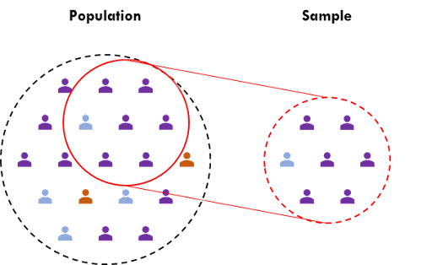
Data Bias: Historical Data Bias: Changes in measurement techniques and station locations over time could make past data less representative of current conditions. Geographical Bias: Data from only 18 European stations may not generalize well to broader regions or global trends. Climate Change Bias: Historical trends might underpredict future events as climate change accelerates, making past data less reflective of future conditions.
Data Set:
The dataset consists of daily weather observations from 18 weather stations across Europe, spanning from the late 1800s to 2022. It includes variables such as temperature, wind speed, snow, and global radiation, collected by the European Climate Assessment & Data Set project.

Slide 5
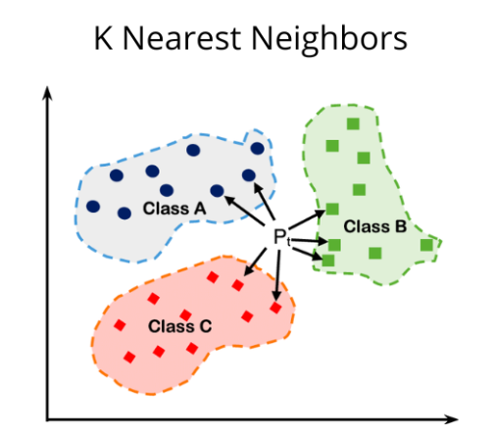
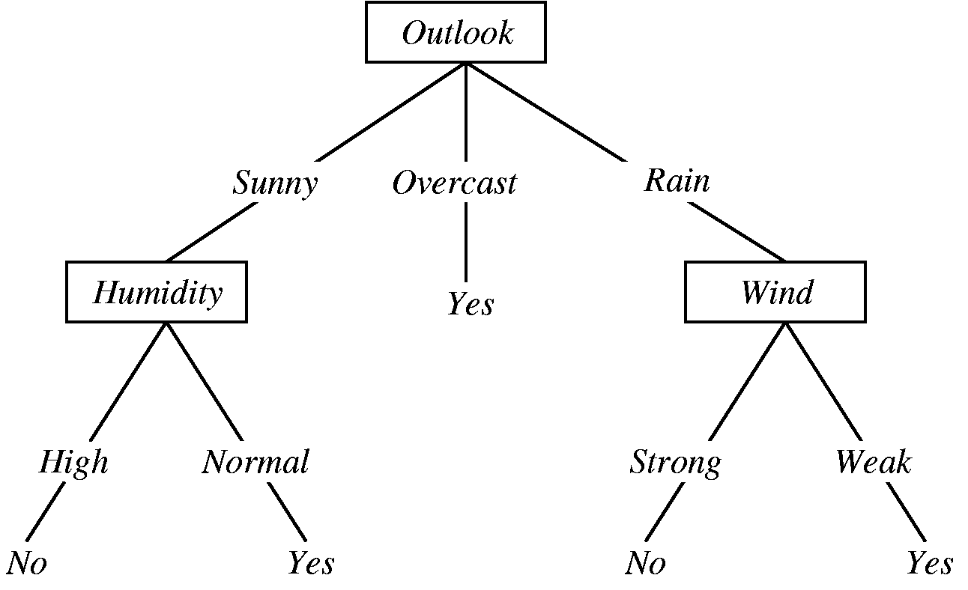
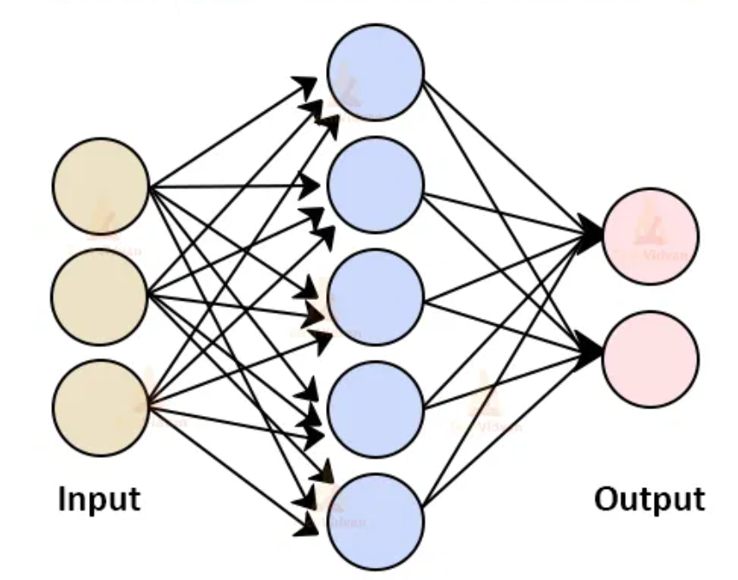
Supervised Machine Learning Models
K-Nearest Neighbors (KNN)
Instance-Based: KNN classifies points by finding the "k" nearest neighbors and assigning the majority class.
No Training: KNN stores the entire dataset and makes predictions by comparing distances during testing.
Artificial Neural Networks (ANN)
Layered Structure: ANN processes input data through layers of neurons, applying weights and activation functions to make predictions.
Backpropagation: It learns by adjusting weights through backpropagation, reducing the error between predictions and actual values.
Decision Tree
Recursive Splitting: Decision trees split data based on the best feature at each node, creating branches until reaching a decision.
Top-Down: The tree grows by selecting features that provide the most information gain, continuing until a final prediction is made.

Slide 6
What Machine Learning Model prediction accuracy
K-Nearest Neighbors (KNN)
Achieves a training accuracy between 45% and 55% and a test accuracy up to 45%.
Accuracy improves as the number of neighbors increases, suggesting better results with more data points considered.
Decision Tree
Lowest performing model with an accuracy of 40%.
May require pruning to improve performance and avoid overfitting.
Artificial Neural Networks (ANN)
Test accuracy does not exceed 45%, indicating this may not be the most suitable model for the dataset.

Slide 7
Conclusion
K-Nearest Neighbors (KNN) is identified as the best-suited model for the task.
KNN shows steady improvements in accuracy as the number of neighbors increases.
Data may be skewed by biases, possibly due to a limited number of weather stations and historical inconsistencies.
Predicting the weather is inherently challenging.
Climate change is increasingly altering weather patterns, making future events more difficult to model accurately.

Slide 8
Next Steps
Apply Unsupervised ML: Implement unsupervised machine learning techniques to see if they yield better results in predicting weather conditions.
Collect Additional Data: Gather weather data from other geographical regions.
Test Algorithms: Evaluate how the algorithms perform with this additional data to assess their effectiveness across diverse locations.

